Slide 1
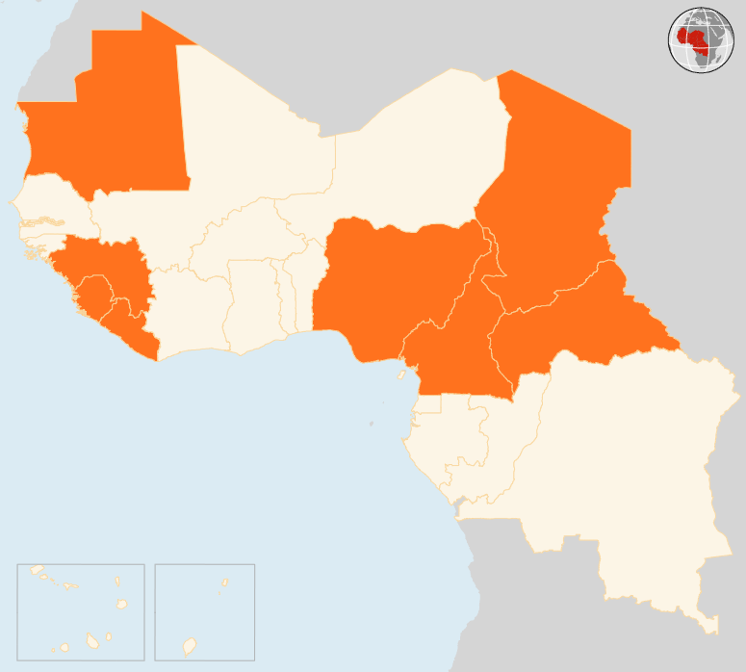

6 – 12 Oct 2015
CAMEROON
SUICIDE ATTACK KILLS NINE
At least nine people were killed and around 30 wounded on 11 October in a double suicide bombing in Kangaleri village in Cameroon’s Far North region. Boko Haram insurgents are suspected to be behind the bombing in the region which has suffered no less than 15 such attacks since July.
CENTRAL AFRICAN REPUBLIC (CAR)
PERSISTENT INSECURITY
Despite gradual return of calm in Bangui after recent clashes, insecurity and humanitarian access difficulties remain. Emergency health, nutrition and sanitation assistance are being carried out amid the insecurity and constrained movement in the city’s districts that were hit by the violence that erupted on 26 September. Meanwhile, an estimated 15,600 children in Bangui are out of school due to displacement and insecurity.
CHAD
MULTIPLE BLASTS KILL 43
On 10 October, five simultaneous suicide blasts hit the central market in Baga Sola town and a site hosting displaced people in Kousseri area, killing at least 43 people and injuring around 60 others. Two women and three girls (aged between 10 and 15) are suspected to have carried out the attack. The Kousseri displacement site hosts 7,300 people who fled for safety there in July following militant attacks.
GUINEA
NINE KILLED IN PRE-POLL VIOLENCE, ELECTION DAY CALM
On 11 October, presidential elections were conducted without major incidents. The poll was, however, preceded by days of violent clashes that left nine people dead in the capital Conakry and in Banankoro sub-prefecture in the south-east. No significant population movement was noted.
NIGERIA
SEVENTEEN KILLED IN SUICIDE ATTACKS
At least 17 people were killed in a series of suicide attacks in north-east Nigeria on 7 October. The worst of the violence struck Yobe, the capital of Damaturu State, which was rocked by triple blasts that killed 14 people and left 10 others injured. In neighbouring Borno State three people were killed in a suicide bombing in Gubio area, some 85 kilometres from the state capital Maiduguri.
MAURITANIA
RIFT VALLEY FEVER KILLS EIGHT
Mauritania’s Health Ministry on 7 October announced that eight people have died of Rift Valley Fever. Twenty-five cases have been reported, out of which eight have been confirmed. The disease was first detected in early September in the southern Moudjéria area. The authorities have, among other measures, set up a joint Health and Livestock ministries’ cell to monitor the situation. Medical teams in referral hospitals in the capital Nouakchott and surveillance missions have been dispatched to the ground.
EVD REGIONAL
0 NEW CASES REPORTED
In the week ending on 11 October, there were no confirmed cases in Guinea, Liberia and Sierra Leone. The week that ended on 4 October had marked the first time since March 2014 that the three countries did not report any new cases. As of 9 October, Liberia had gone for 89 days without any cases. The last EVD patients in Sierra Leone were discharged on 26 September, while Guinea last reported cases on 27 September.
MAURITANIA
8
DIE OF RVF
CHAD
43
KILLED IN MULTIPLE BLASTS
GUINEA
9
DEAD IN PRE-POLL VIOLENCE
NIGERIA
17
DIE IN BOMB ATTACKS
CAR
INSECURITY PERSISTS
EVD REGIONAL
0
NEW CASES REPORTED
CAMEROON
9
KILLED IN SUICIDE ATTACK
Creation date: 13 October 2015 Map data sources: UNCS, DevInfo, OCHA. Feedback: ocharowca@un.org
The boundaries and names shown and the designations used on this map do not imply official endorsement or acceptance by the United Nations.

